Slide 1
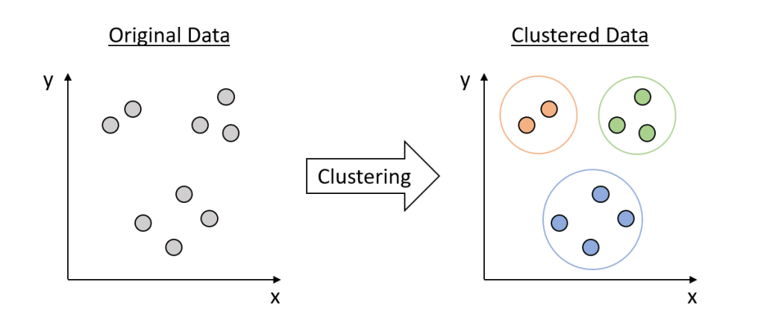
Clustering
9
- Dr. Sifat Momen (SfM1)

Slide 2
Learning goals
After this presentation, you should be able to
Understand what clustering is
Understand the different types of clustering
Apply Kmeans clustering algorithm
Understand the notion of silhouette clustering

Slide 3
What is Clustering?
Also called unsupervised learning, sometimes called classification by statisticians and sorting by psychologists and segmentation by people in marketing
Organizing data into classes such that there is
high intra-class similarity
low inter-class similarity
Finding the class labels and the number of classes directly from the data (in contrast to classification).
More informally, finding natural groupings among objects.

Slide 4
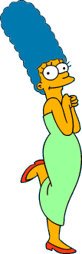

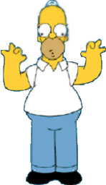

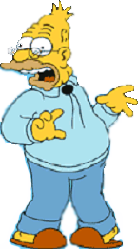
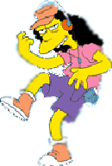


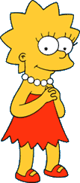
What is a natural grouping among these objects?

Slide 5

What is a natural grouping among these objects?
Clustering is subjective
Simpson's Family
School Employees
Females
Males

Slide 6
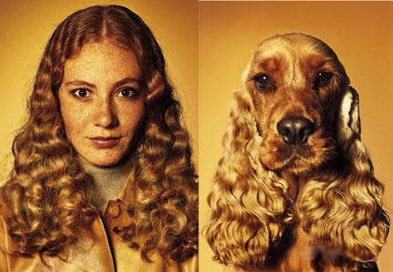
What is Similarity?
The quality or state of being similar; likeness; resemblance; as, a similarity of features.
Webster's Dictionary
Similarity is hard to define, but…
“We know it when we see it”
The real meaning of similarity is a philosophical question. We will take a more pragmatic approach.

Slide 7


Two Types of Clustering
Partitional algorithms: Construct various partitions and then evaluate them by some criterion (we will see an example called BIRCH)
Hierarchical algorithms: Create a hierarchical decomposition of the set of objects using some criterion
Hierarchical
Partitional

Slide 8







Partitional Clustering
Nonhierarchical, each instance is placed in exactly one of K nonoverlapping clusters.
Since only one set of clusters is output, the user normally has to input the desired number of clusters K.

Slide 9
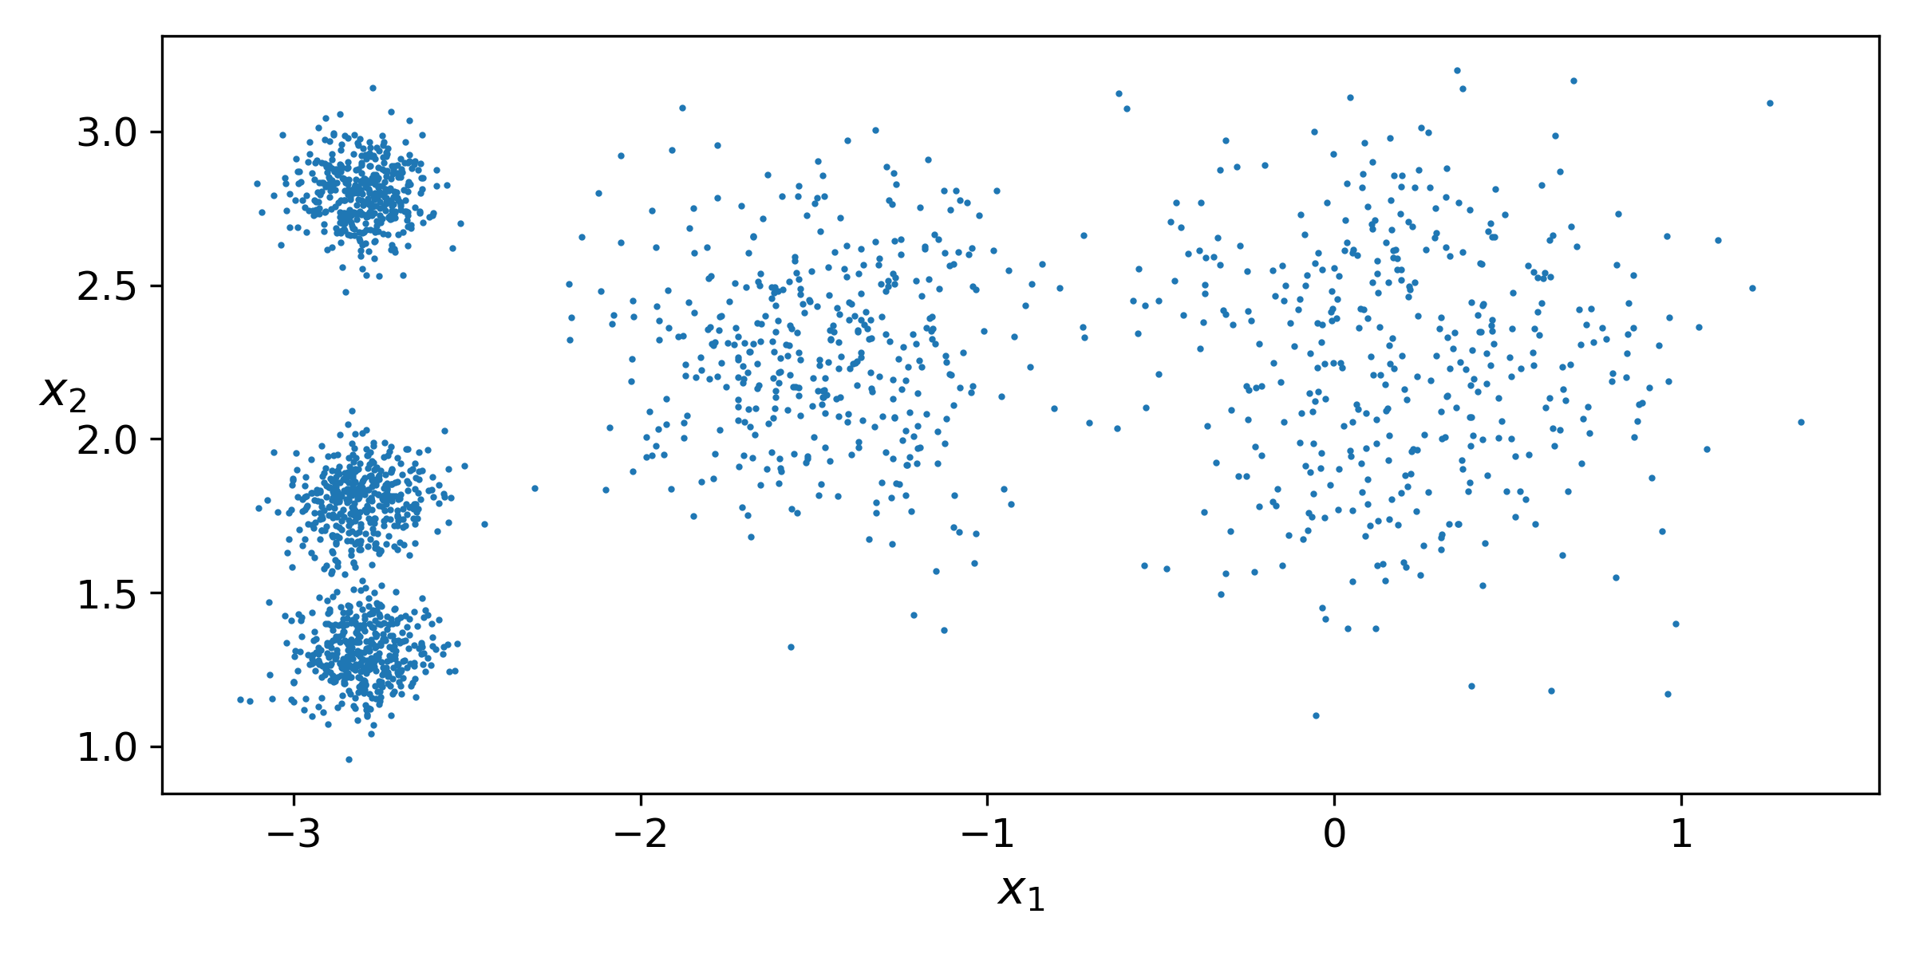
Unlabeled Dataset

Slide 10
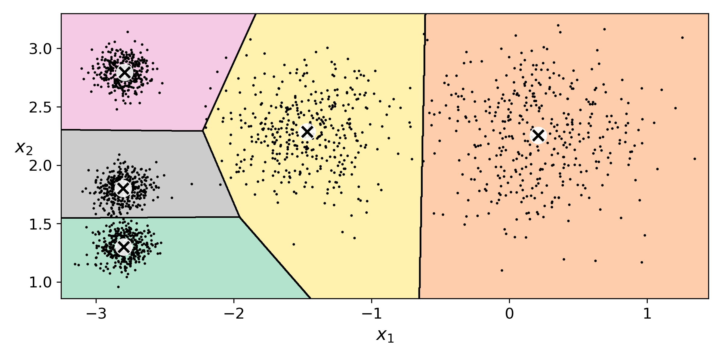
After clustering (Decision Boundaries)
[Also called Voronoi diagram or Voronoi tesselation]

Slide 11
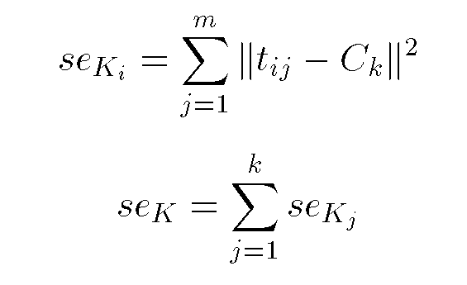
Squared Error
10
9
8
7
6
5
4
3
2
1
1
2
3
4
5
6
7
8
9
10
Objective Function

Slide 12
Algorithm k-means
1. Decide on a value for k.
2. Initialize the k cluster centers (randomly, if necessary).
3. Decide the class memberships of the N objects by assigning them to the nearest cluster center.
4. Re-estimate the k cluster centers, by assuming the memberships found above are correct.
5. If none of the N objects changed membership in the last iteration, exit. Otherwise goto 3.

Slide 13
K-means Clustering: Step 1
Algorithm: k-means, Distance Metric: Euclidean Distance
5
4
k₁
3
k₂
2
1
k₃
0
0
1
2
3
4
5

Slide 14
K-means Clustering: Step 2
Algorithm: k-means, Distance Metric: Euclidean Distance
5
4
k₁
3
k₂
2
1
k₃
0
0
1
2
3
4
5

Slide 15
K-means Clustering: Step 3
Algorithm: k-means, Distance Metric: Euclidean Distance
5
4
k₁
3
2
k₃
k₂
1
0
0
1
2
3
4
5

Slide 16
K-means Clustering: Step 4
Algorithm: k-means, Distance Metric: Euclidean Distance
5
4
k₁
3
2
k₃
k₂
1
0
0
1
2
3
4
5

Slide 17
K-means Clustering: Step 5
Algorithm: k-means, Distance Metric: Euclidean Distance
k₁
k₂
k₃

Slide 18
Comments on the K-Means Method
Strength
Relatively efficient: O(tkn), where n is # objects, k is # clusters, and t is # iterations. Normally, k, t << n.
Often terminates at a local optimum. The global optimum may be found using techniques such as: deterministic annealing and genetic algorithms
Weakness
Applicable only when mean is defined, then what about categorical data?
Need to specify k, the number of clusters, in advance
Unable to handle noisy data and outliers
Not suitable to discover clusters with non-convex shapes

Slide 19
How can we tell the right number of clusters?
In general, this is a unsolved problem. However there are many approximate methods. In the next few slides we will see an example.
10
9
For our example, we will use the familiar katydid/grasshopper dataset.
However, in this case we are imagining that we do NOT know the class labels. We are only clustering on the X and Y axis values.
8
7
6
5
4
3
2
1
1
2
3
4
5
6
7
8
9
10

Slide 20
When k = 1, the objective function is 873.0
1
2
3
4
5
6
7
8
9
10

Slide 21
When k = 2, the objective function is 173.1
1
2
3
4
5
6
7
8
9
10

Slide 22
When k = 3, the objective function is 133.6
1
2
3
4
5
6
7
8
9
10

Slide 23
We can plot the objective function values for k equals 1 to 6…
The abrupt change at k = 2, is highly suggestive of two clusters in the data. This technique for determining the number of clusters is known as “knee finding” or “elbow finding”.
1.00E+03
9.00E+02
8.00E+02
7.00E+02
6.00E+02
Objective Function
5.00E+02
4.00E+02
3.00E+02
2.00E+02
1.00E+02
0.00E+00
k
1
2
3
4
5
6
Note that the results are not always as clear cut as in this toy example

Slide 24
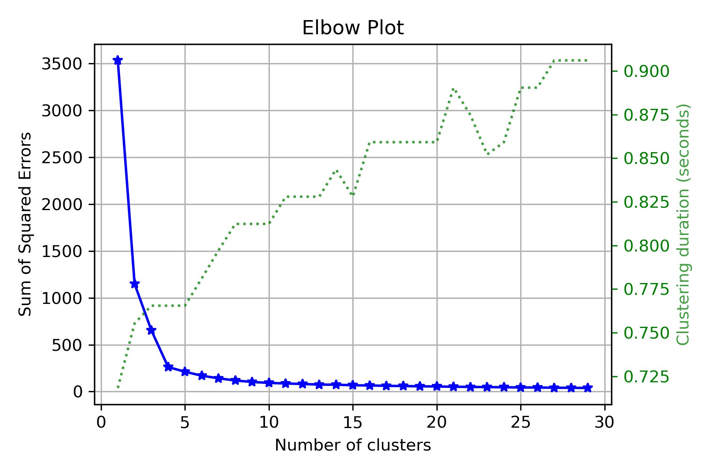

Slide 25
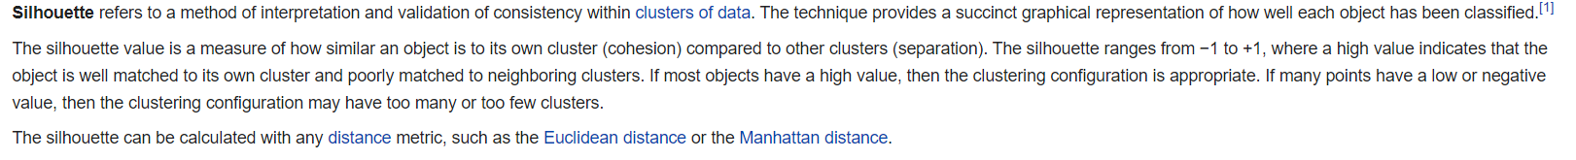

Slide 26
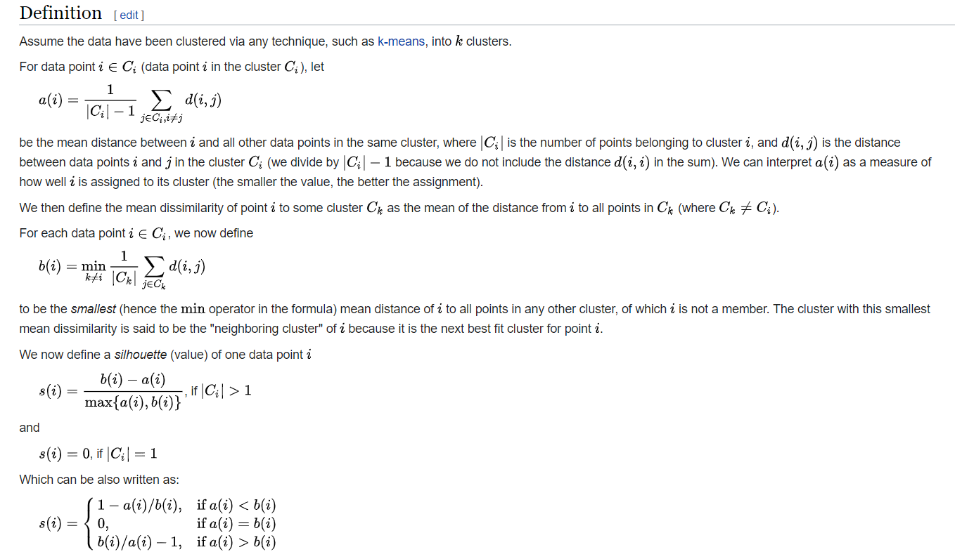

Slide 27
